Slide 1
THIS IS AMERICA
A Text Analysis of YouTube Comments from Childish Gambino’s This is America Music Video

Slide 2
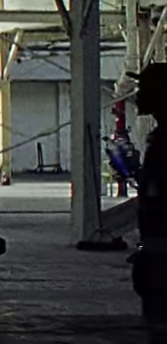
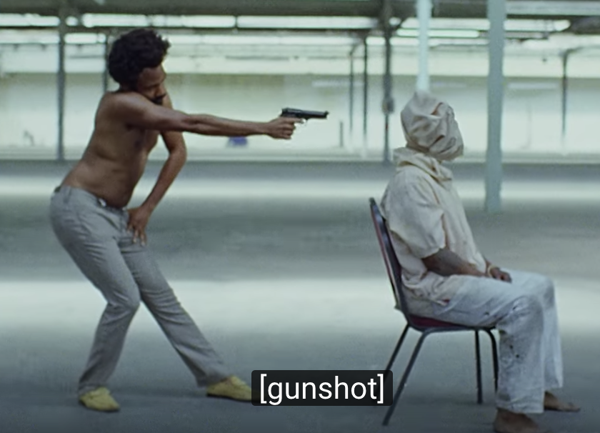
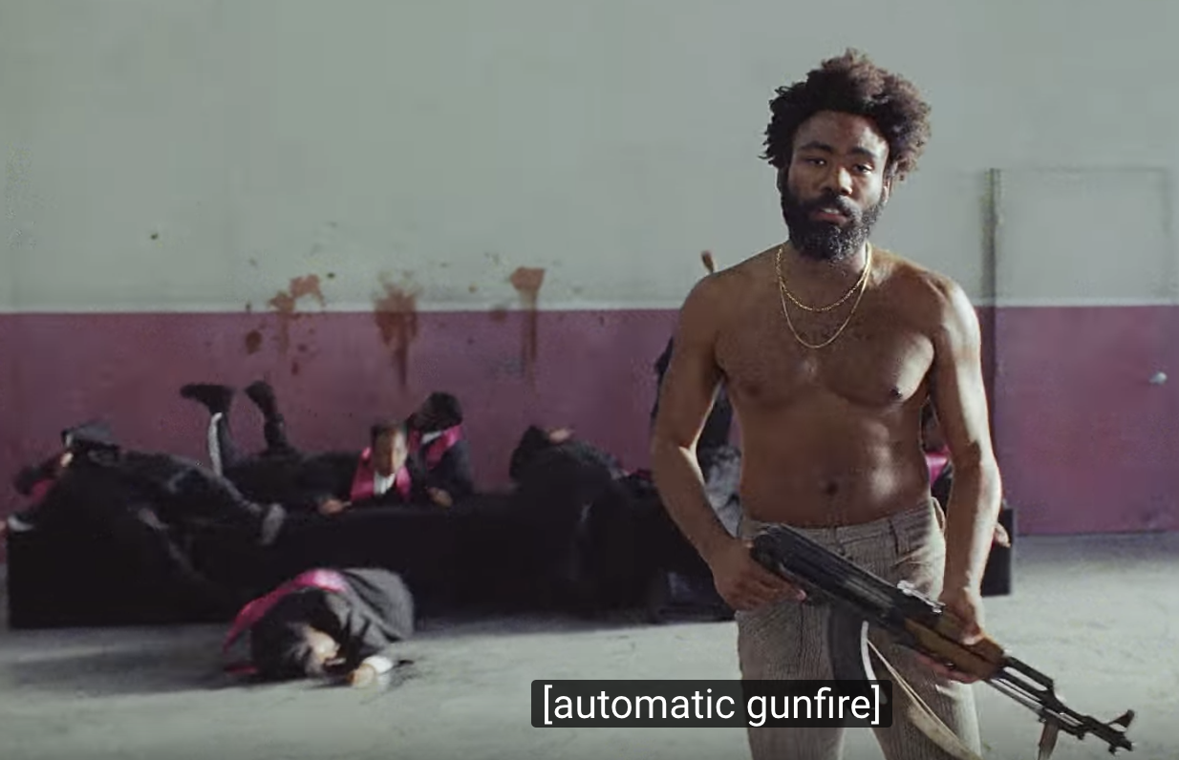
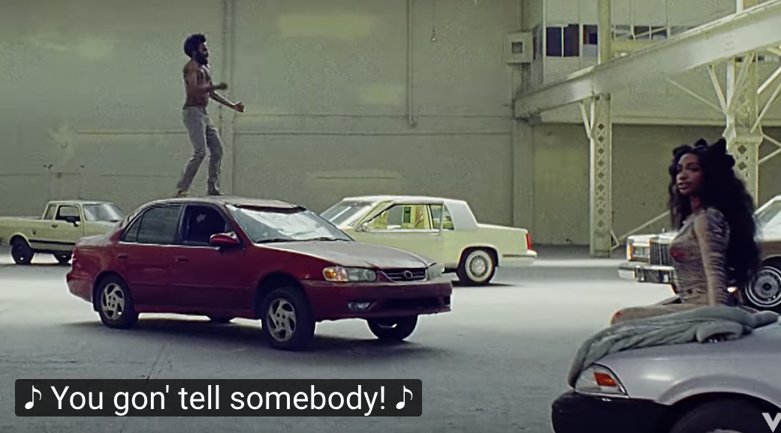
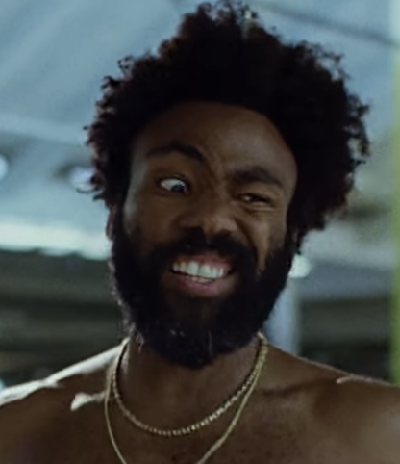
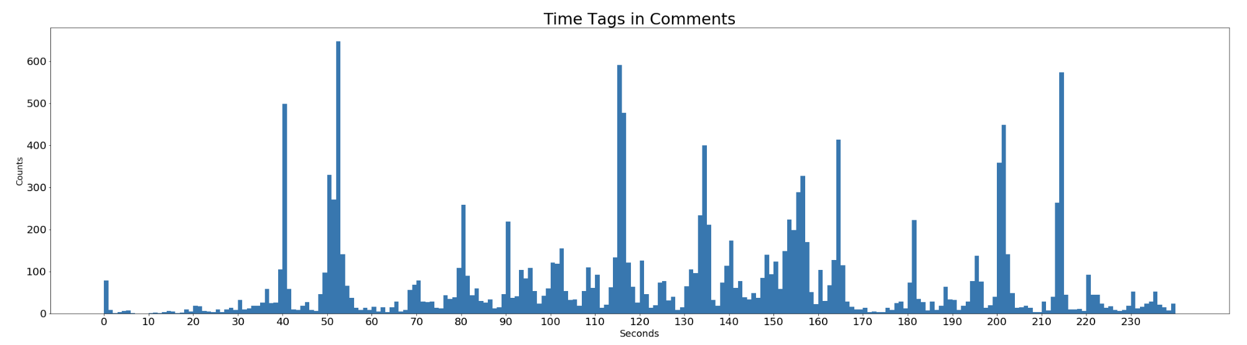
Most Tagged Times in the Video
Preprocessing:
Used regex to pull any time someone tagged a time in their comment
Removed time tags that were longer than the video length
Gambino shoots a man in the back of the head in a similar stance to that of a Jim Crow caricature
Gambino guns down a church choir which is a reference to the 2015 Charleston church shooting
SZA makes a cameo appearance
Production guy holding a water bottle spotted
Childish Gambino made this iconic face

Slide 3
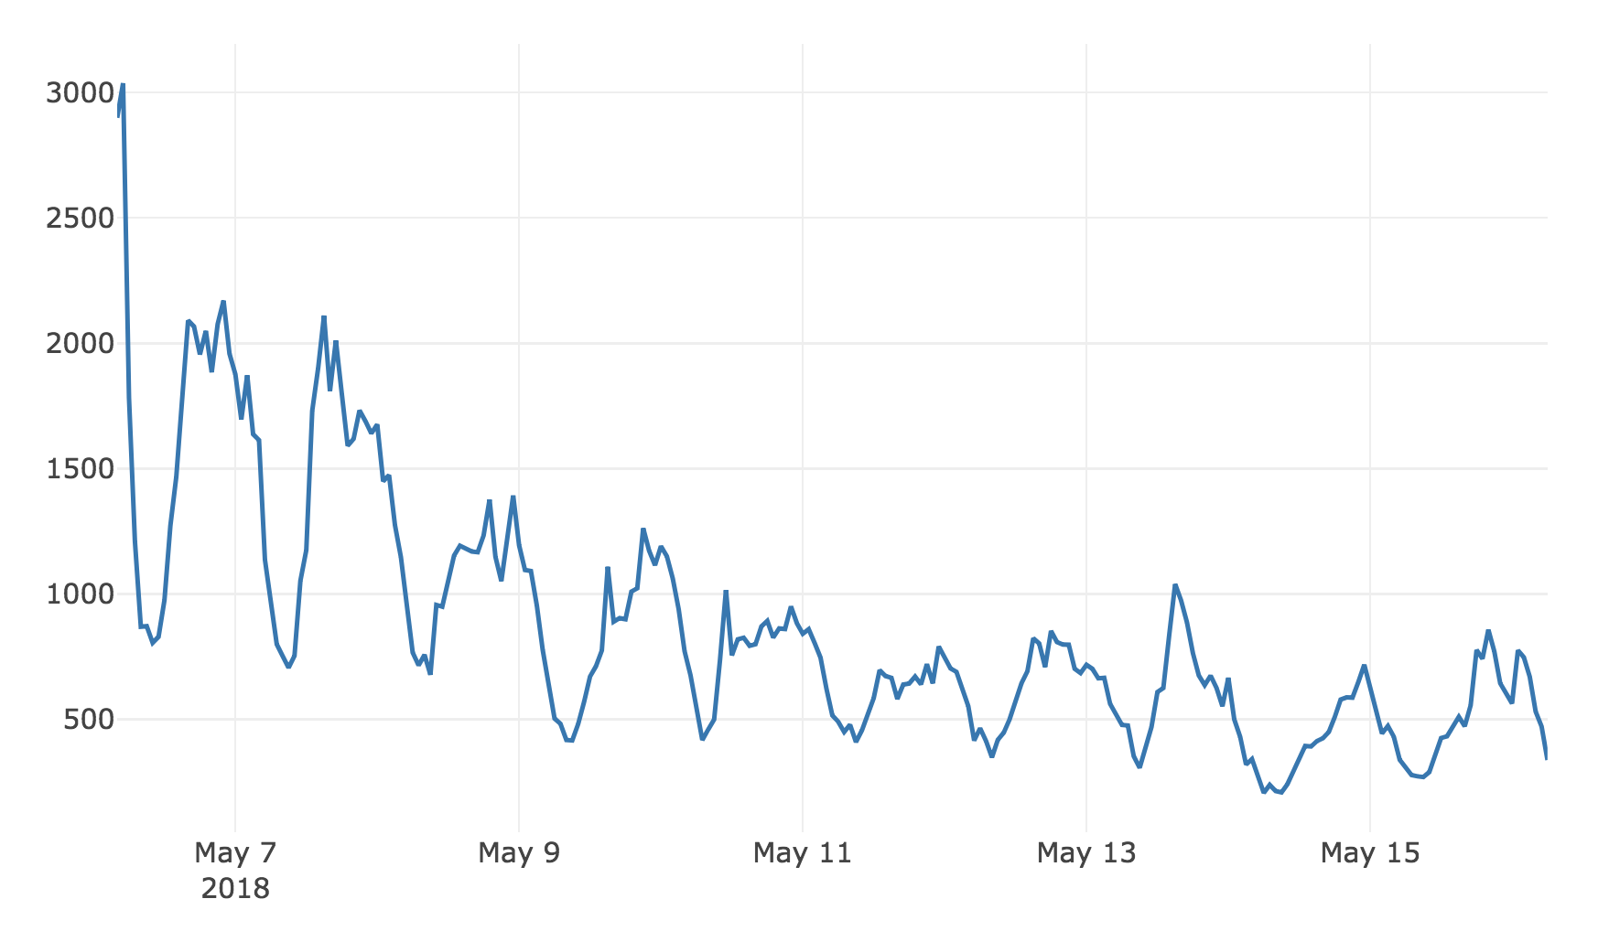
Number of Comments Made by Hour and Day
Preprocessing:
Floored each comment publishing time to to previous hour

Slide 4
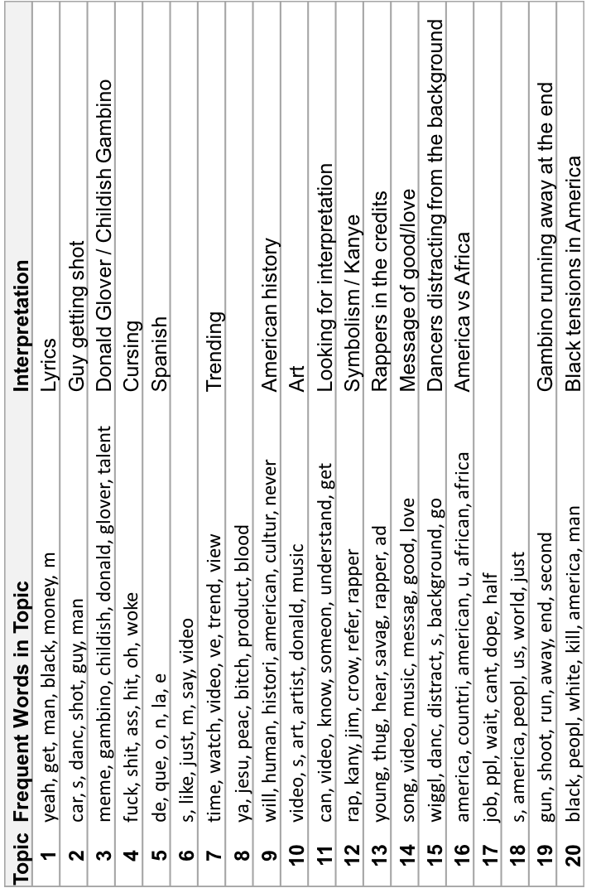
Preprocessing:
Lowercased, tokenized, and stemmed words
Removed numbers
Only kept comments with at least 75 characters
Modeling:
Tried different LDA models with different number of topics
Prevalent Topics People Talked About

Slide 5
Topic | Frequent Words in Topic | Interpretation
1 | yeah, get, man, black, money, m | Lyrics
2 | car, s, danc, shot, guy, man | Guy getting shot
3 | meme, gambino, childish, donald, glover, talent | Donald Glover / Childish Gambino
4 | fuck, shit, ass, hit, oh, woke | Cursing
5 | de, que, o, n, la, e | Spanish
6 | s, like, just, m, say, video
7 | time, watch, video, ve, trend, view | Trending
8 | ya, jesu, peac, bitch, product, blood
9 | will, human, histori, american, cultur, never | American history
10 | video, s, art, artist, donald, music | Art
11 | can, video, know, someon, understand, get | Looking for interpretation
12 | rap, kany, jim, crow, refer, rapper | Symbolism / Kanye
13 | young, thug, hear, savag, rapper, ad | Rappers in the credits
14 | song, video, music, messag, good, love | Message of good/love
15 | wiggl, danc, distract, s, background, go | Dancers distracting from the background
16 | america, countri, american, u, african, africa | America vs Africa
17 | job, ppl, wait, cant, dope, half
18 | s, america, peopl, us, world, just
19 | gun, shoot, run, away, end, second | Gambino running away at the end
20 | black, peopl, white, kill, america, man | Black tensions in America

